Slide 1
Automotive Component

Slide 2
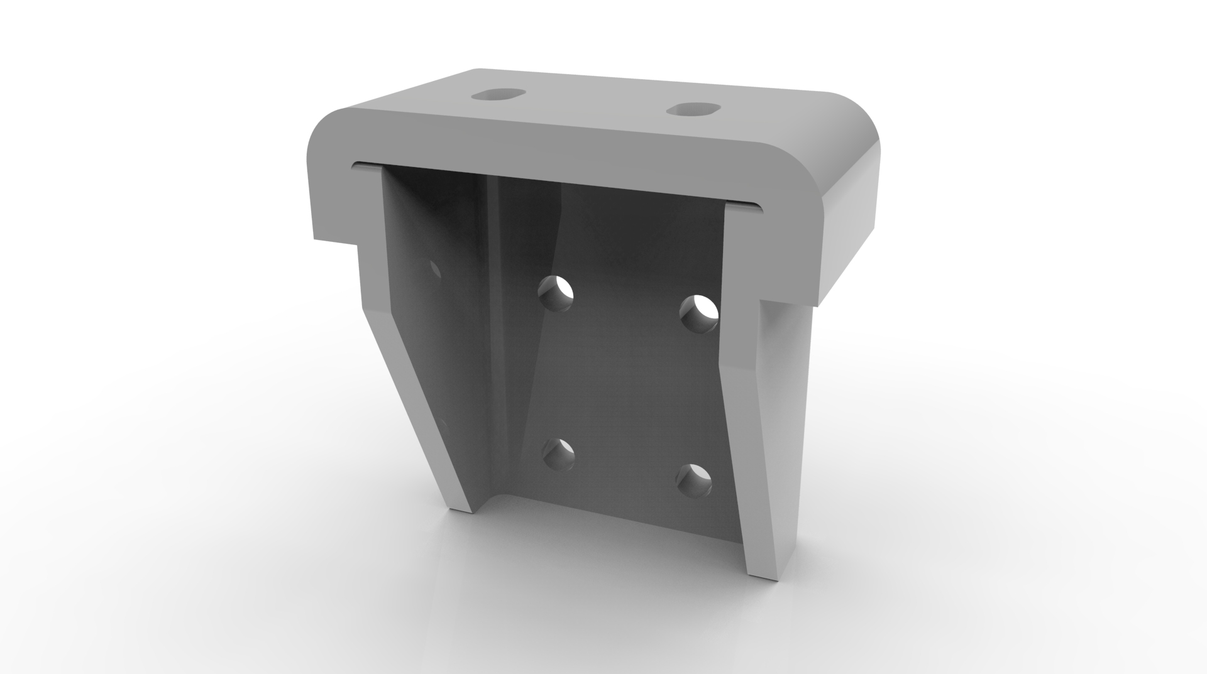
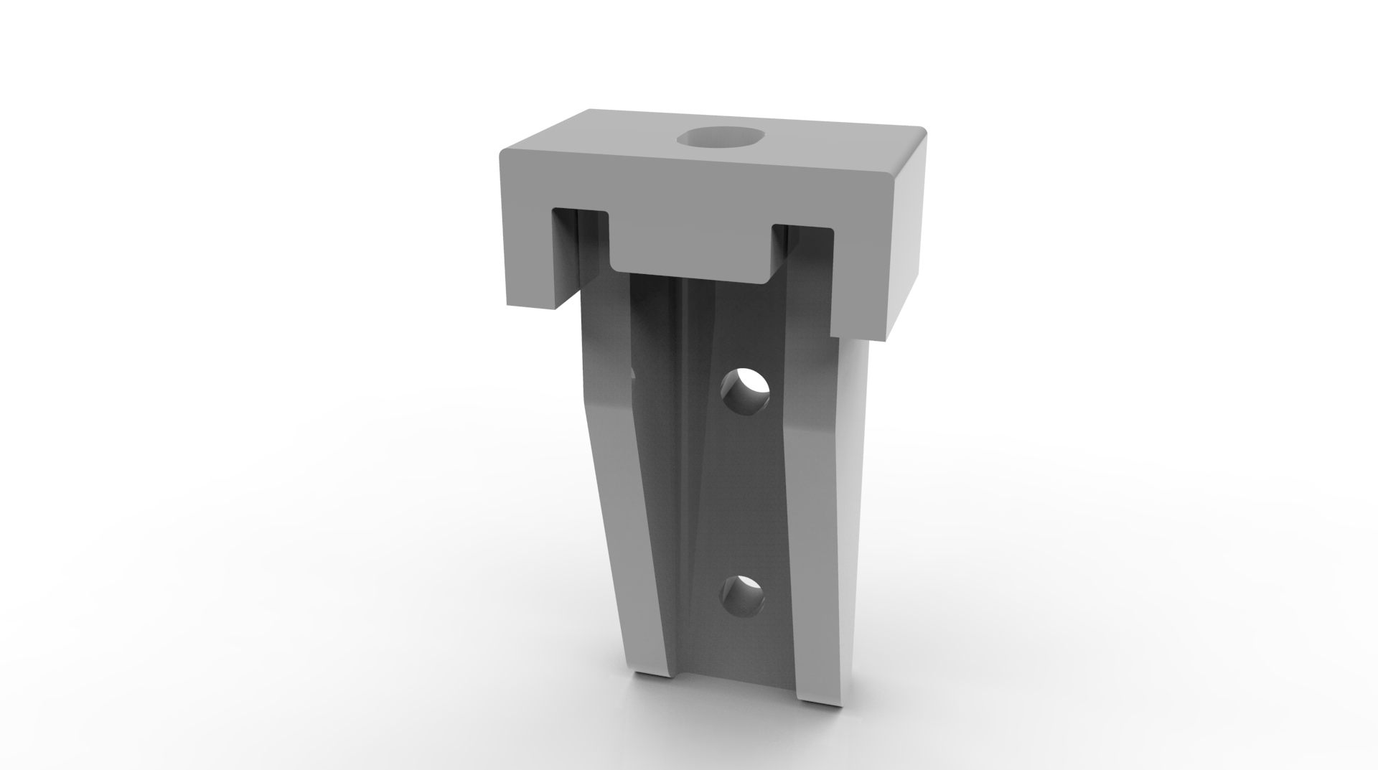
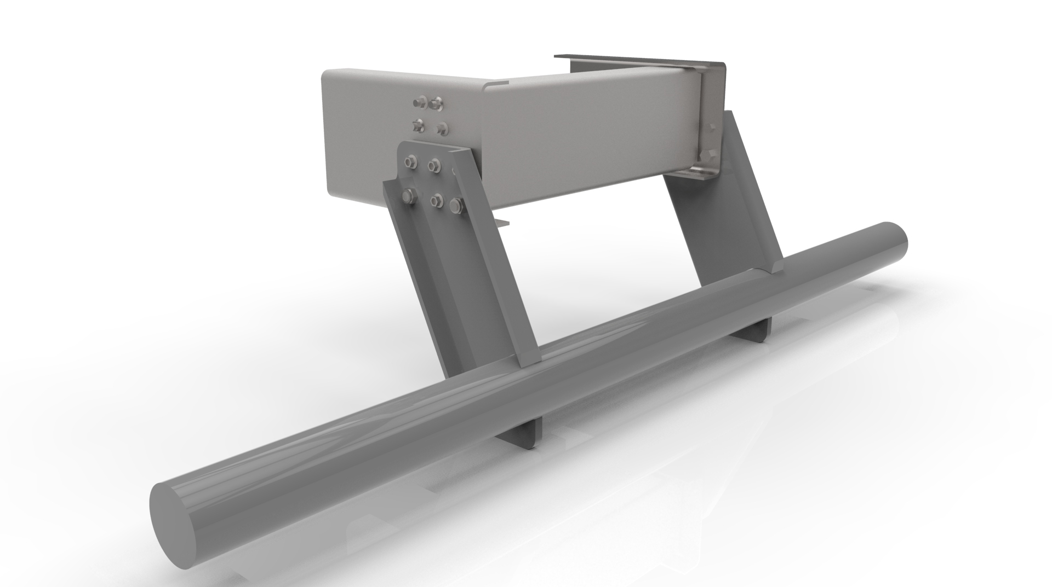
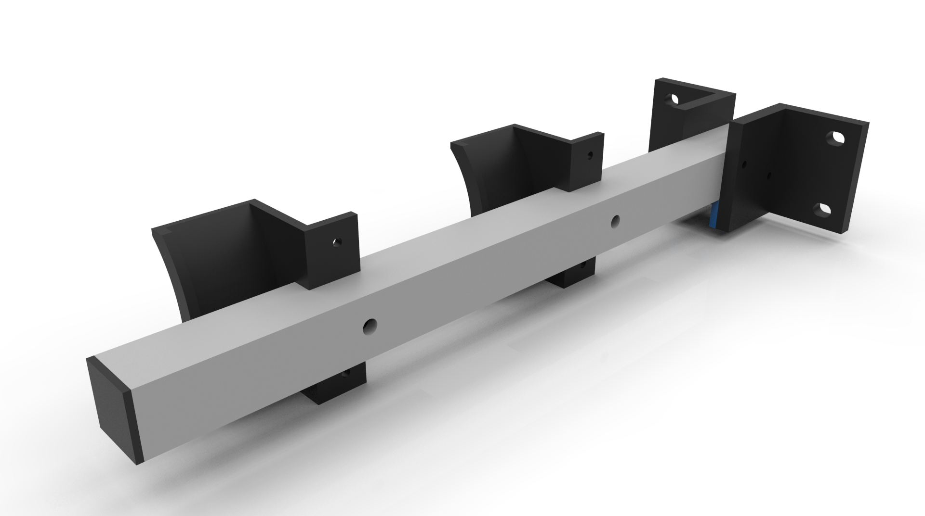
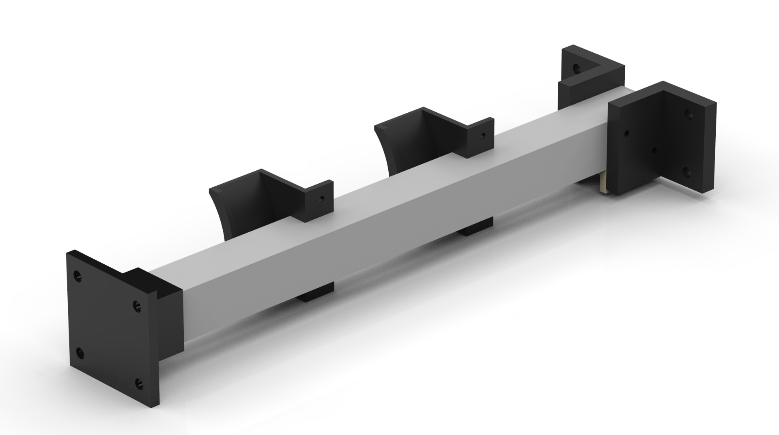
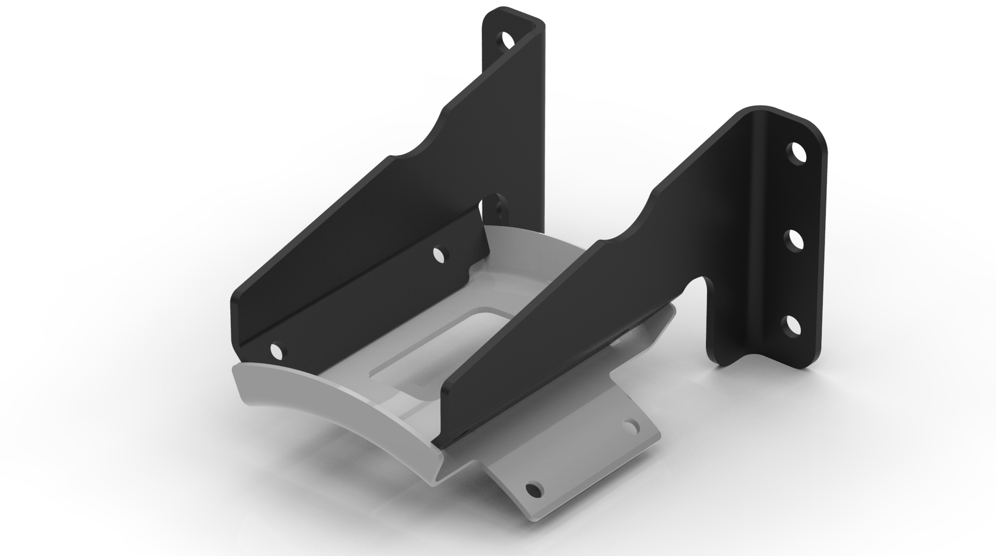
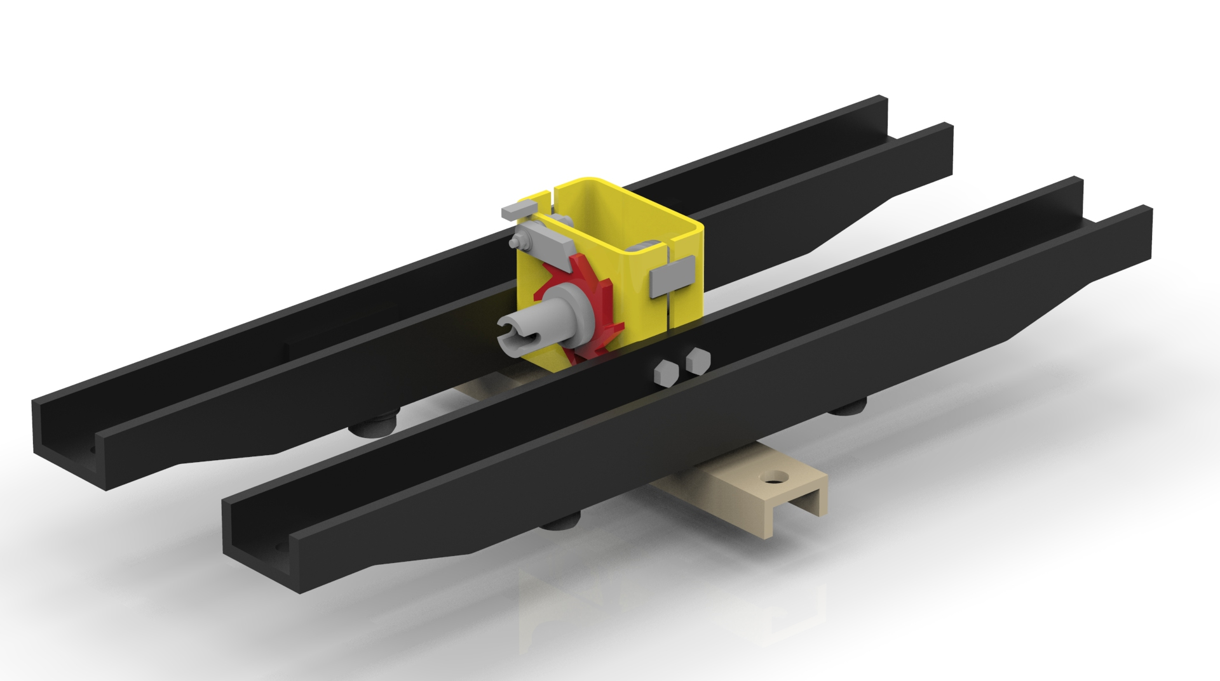
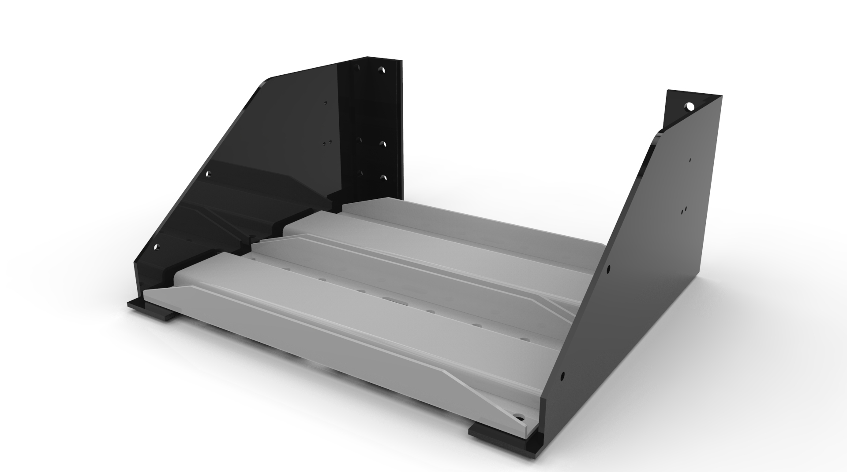
CASE STUDY
Scope/Objective:
Develop Mass Efficient Design Solutions With Advanced FRP Applications For commercial vehicles.
Structure Assembly resistance to Transient Load, Vertical Load- 5g, Braking -3g, Longitudinal+1g Vertical, Cornering- 3g, Lateral+1g Vertical and match modal frequency of more than 22 Hz.
Input :
CAD data/FE models of Solar Structure, Material properties.
Design Steps:
Component Concept generation.
Generation 3D CAD model.
Analysis of Concepts, optimization of each concepts for mass.
Pugh matrix for comparing 3 concepts in terms of Mass, manufacturability, cost and Selection Of Final Concept
Manufacturing Feasibility and Cost Analysis
Design Optimization and Final design

Slide 3
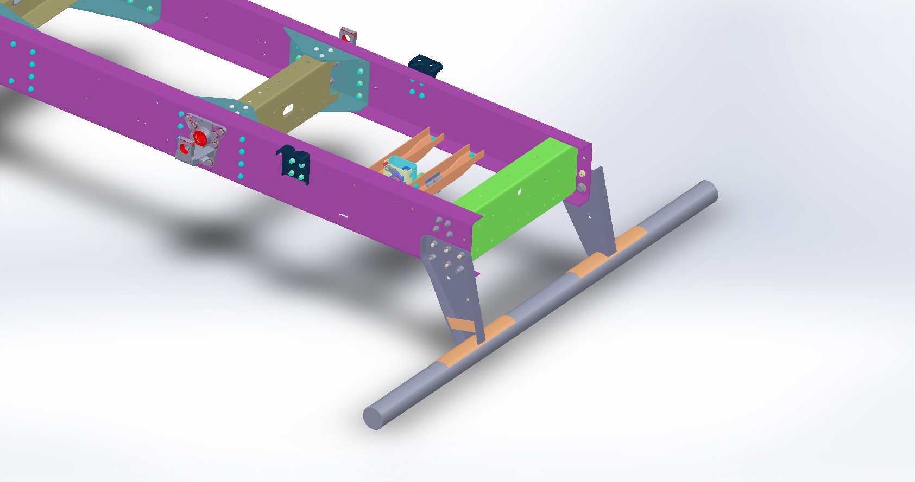
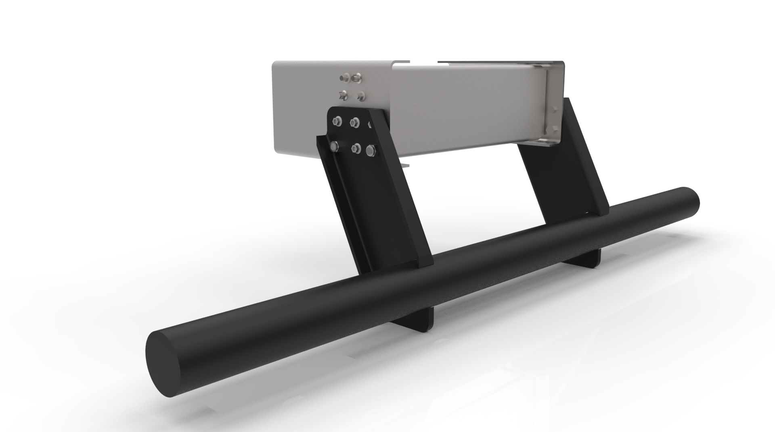
Rear Under Run Protection Device (RUPD)
Customers Objective
PCPL’s Solution :
Mass and Cost Effective different metals parts for commercial vehicle using advanced FRP material
Design Phases :
Concept Design
Proto Phase
Manufacturing Phase
Duration : 11 months
Software used : Solidworks 2016 and Ansys
Initial concept design
Generate CAD model
FEA simulation for Transient Analysis, Modal Analysis, Vertical Load- 5g, Braking -3g, Longitudinal+1g Vertical, Cornering- 3g, Lateral+1g Vertical.
Detail design ready with CAD models, thickness and fillets provided, Manufacturability with Composite rules.
Detailed engineering
Manufacturing drawing
Complete clash and interference analysis for all these component
Inputs Provided
Reference data of (CAD Data-2D/3D)
Carry-over parts CAD-2D/3D
Exploded views of Assembly (Images)
Bill of Material

Slide 4
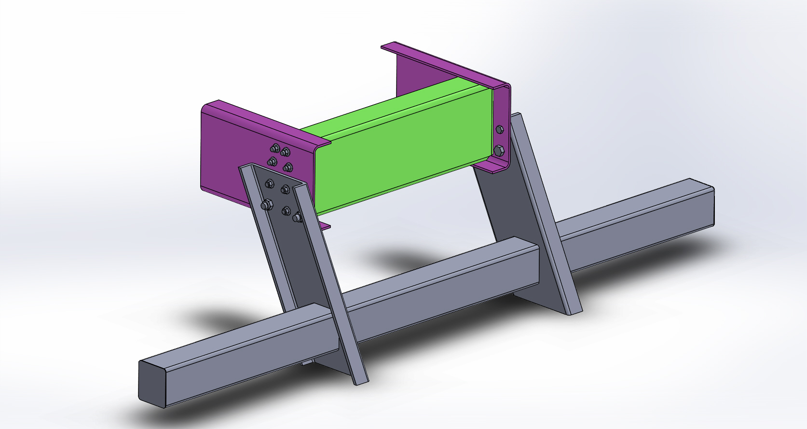
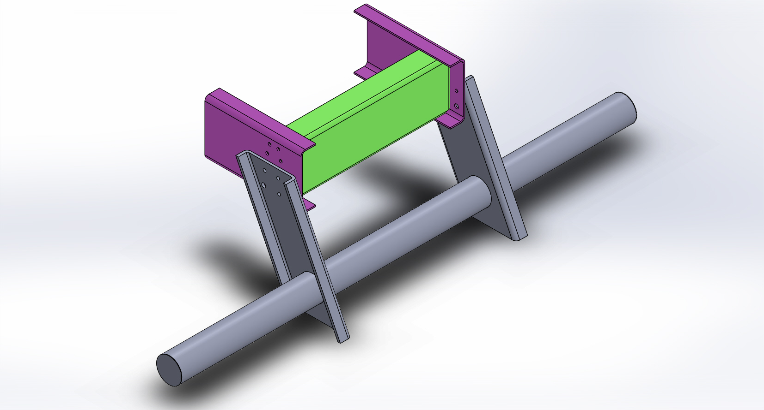
Rear Under Run Protection Device (RUPD)
Description | MS Total Weight | FRP Weight | % Difference in Weight
RUPD Bar | 14.175 | 9.93 | 29.94
RUPD bracket (LHS) | 13.325 | 10.324 | 22.52
RUPD bracket (LHS)
Total Weight (kg) | 27.5 | 20.528 | 25.35
Deliverable:
Different Concepts Developed Into Concrete Designs and Evaluated for Mass, Performance, Cost and Manufacturability
  Concept 1 : New Material (FRP Pultrusion)
  Concept 2 : Optimized mass (New Topology)
  Concept 3 : New Topology and material (Easy Assembly)
Manufacturing feasible final design
Concept 1 Design
Concept 2 Design
Concept 3 Design
Design Changes / New Materials
Design Changes /New Topology
Design Changes / Easy Assembly
Design Steps:
Component Concept generation.
Generation 3D CAD model.
Analysis of Concepts, optimization of each concepts for mass.
Pugh matrix for comparing 3 concepts in terms of Mass, manufacturability, cost and Selection Of Final Concept
Manufacturing Feasibility and Cost Analysis
Design Optimization and Final design
Mass Optimization
Final Design
Manufacturing feasibility

Slide 5
Rear Under Run Protection Device (RUPD)
CONCLUSION:
  The total mass reduction achieved in the modified case is 11.6 kg
  Overall 26% mass reduction.
  Improves power to weight ratio.
  Cost reduction by 15%.
  Simplifies assembly of the system.
  Reduces production cost, inventory and labor cost etc.

Slide 6
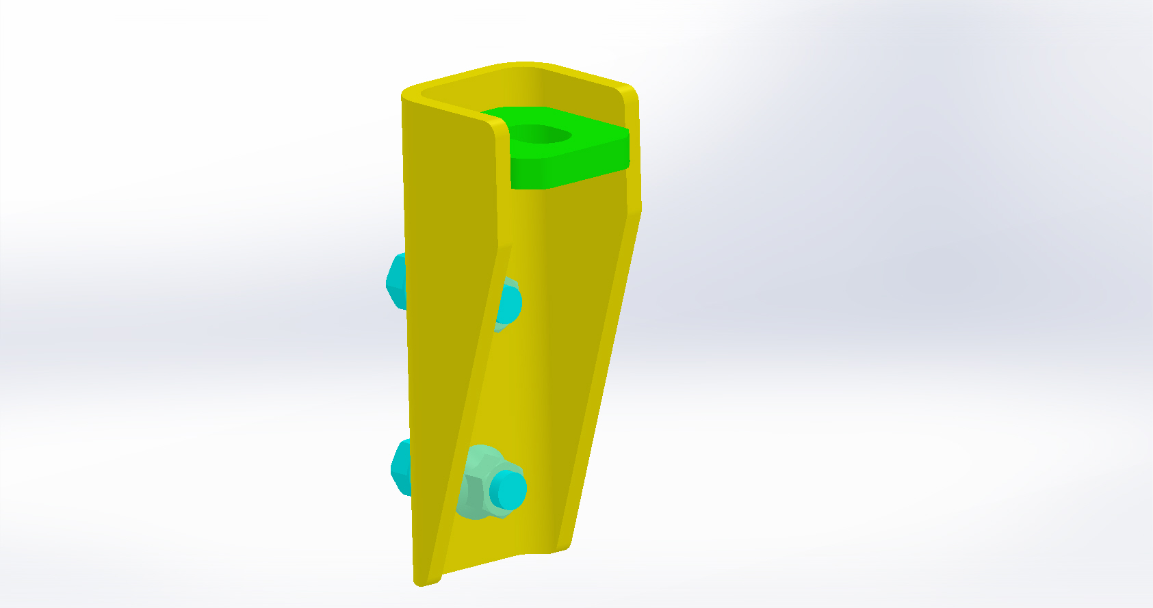
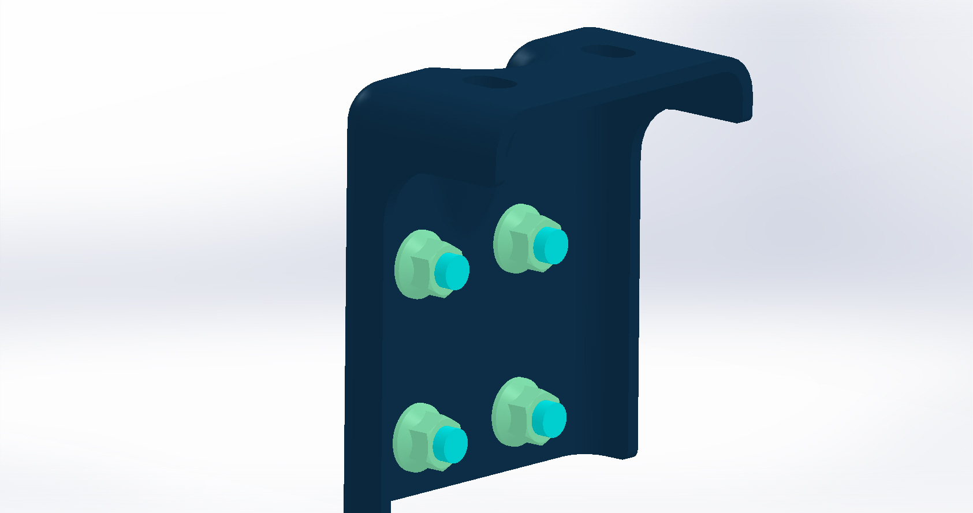
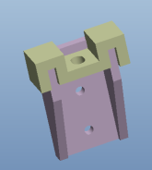
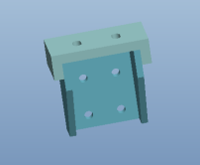
Outrigger : 1 hole & 2 hole
Concept 1 Design
Concept 2 Design
Concept 1 Design
Concept 2 Design
Design Changes / New Materials
Design Changes /New Topology
Design Changes / New Materials
Design Changes /New Topology
Mass Optimization
Final Design
Manufacturing feasibility
Mass Optimization
Final Design
Manufacturing feasibility

Slide 7
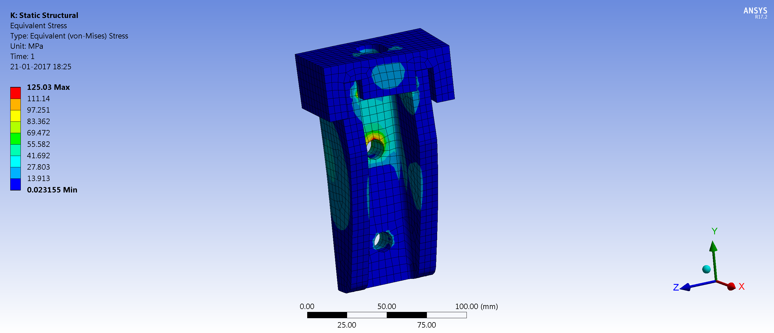
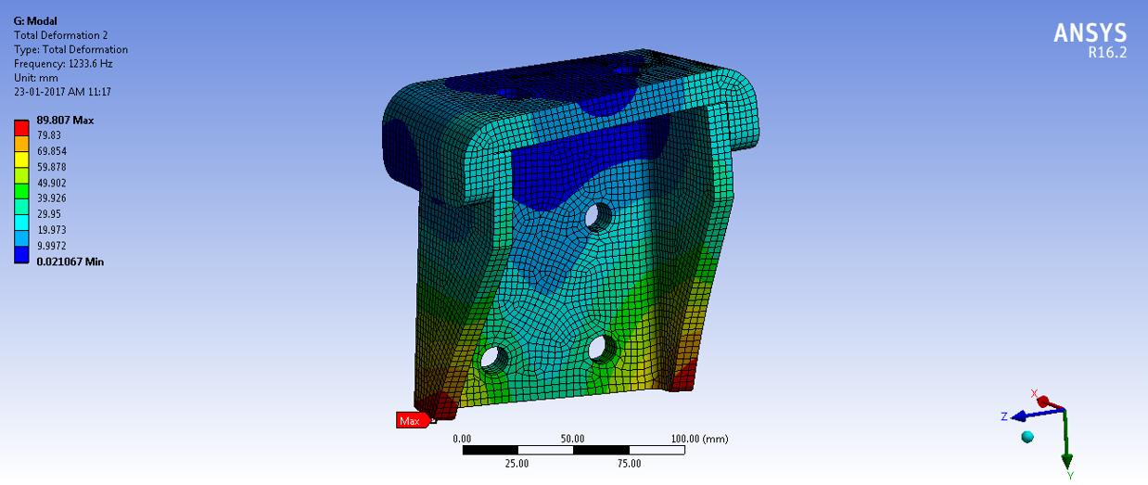
Outrigger : 1 hole & 2 hole
Outrigger 1 hole
Outrigger 2 hole
Description | MS Total Weight | FRP Weight | % Difference in Weight
Total Weight (kg) | 1.0 | 0.571 | 42.78
Description | MS Total Weight | FRP Weight | % Difference in Weight
Total Weight (kg) | 1.26 | 0.829 | 34.20
Deliverable:
Different Concepts Developed Into Concrete Designs and Evaluated for Mass, Performance, Cost and Manufacturability
  Concept 1 : New Material (FRP Pultrusion)
  Concept 2 : Optimized mass (New Topology)
Manufacturing feasible final design
Deliverable:
Different Concepts Developed Into Concrete Designs and Evaluated for Mass, Performance, Cost and Manufacturability
  Concept 1 : New Material (FRP Pultrusion)
  Concept 2 : Optimized mass (New Topology)
Manufacturing feasible final design

Slide 8
Outrigger : 1 hole & 2 hole
CONCLUSION:
  The total mass reduction achieved in the modified case are 500 gm for outrigger 1 hole and 431 gm for outrigger 2 hole.
  Overall mass reduction for outrigger 1 hole : 42.78% and for outrigger 2 hole : 34.2% .
  Improves power to weight ratio.
  Cost reduction per Product by 18%.
  Simplifies assembly of the system.
  Reduces production cost, inventory and labor cost etc.

Slide 9
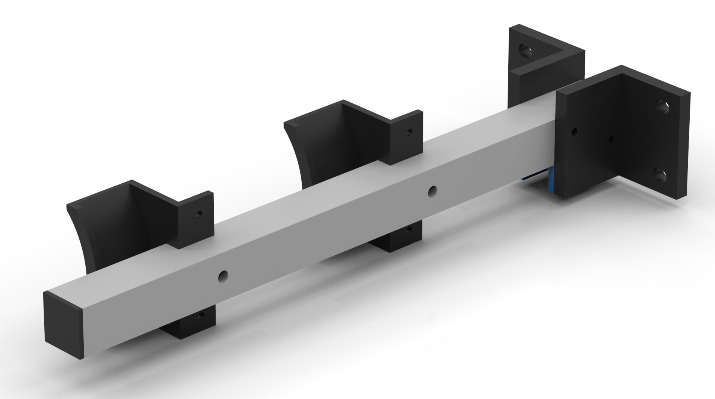
Air tank Mounting
Description | MS Total Weight (Kg) | FRP Weight (Kg) | % Difference in Weight
Air tank Mounting bracket Short | 3.811 | 2.16 | 43.34
Air tank Mounting bracket Long | 5.829 | 3.55 | 32.80
Design Steps:
Component Concept generation.
Generation 3D CAD model.
Analysis of Concepts, optimization of each concepts for mass.
Pugh matrix for comparing concepts in terms of Mass, manufacturability, cost and Selection Of Final Concept
Manufacturing Feasibility and Cost Analysis
Design Optimization and Final design
Air tank Mounting bracket Short
Conclusion:
The total mass reduction achieved in the modified case are 1651 gm for Air tank Mounting bracket Short and 2279 gm for Air tank Mounting bracket Long.
Overall mass reduction for Air tank Mounting bracket Short : 43.34% and for Air tank Mounting bracket Long : 32.80% .
Improves power to weight ratio.
Cost reduction per Product by 18%.
Simplifies assembly of the system.
Reduces production cost, inventory and labour cost etc.
Air tank Mounting bracket Long

Slide 10
Battery and Wheel Mounting
Description | MS Total Weight (Kg) | FRP Weight (Kg) | % Difference in Weight
Battery Mounting Assembly | 9.614 | 5.83 | 39.40
SWC Assembly | 17.5 | 6.09 | 65.18
Design Steps:
Component Concept generation.
Generation 3D CAD model.
Analysis of Concepts, optimization of each concepts for mass.
Pugh matrix for comparing concepts in terms of Mass, manufacturability, cost and Selection Of Final Concept
Manufacturing Feasibility and Cost Analysis
Design Optimization and Final design
Battery Mounting Assembly
Conclusion:
The total mass reduction achieved in the modified case are 3.78 kg for Battery Mounting Assembly and 11.41 kg for SWC Assembly.
Overall mass reduction for Battery Mounting Assembly : 39.40 % and for SWC Assembly : 65.18% .
Improves power to weight ratio.
Cost reduction per Product by 18%.
Simplifies assembly of the system.
Reduces production cost, inventory and labour cost etc.
SWC Assembly

Slide 11
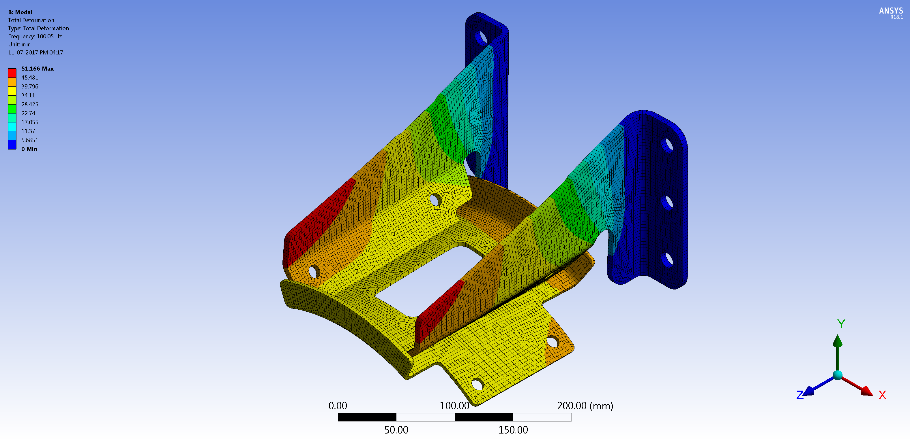
Muffler Mounting
Description | MS Total Weight (Kg) | FRP Weight (Kg) | % Difference in Weight
Air tank Mounting bracket Short | 3.646 | 1.9 | 47.88
Design Steps:
Component Concept generation.
Generation 3D CAD model.
Analysis of Concepts, optimization of each concepts for mass.
Pugh matrix for comparing concepts in terms of Mass, manufacturability, cost and Selection Of Final Concept
Manufacturing Feasibility and Cost Analysis
Design Optimization and Final design
Muffler Mounting
Conclusion:
The total mass reduction achieved in the modified case is 1.746 kg.
Overall 47.88 % mass reduction.
Improves power to weight ratio.
Cost reduction per Product by 18%.
Simplifies assembly of the system.
Reduces production cost, inventory and labour cost etc.

