Slide 1
Solar Structure

Slide 2
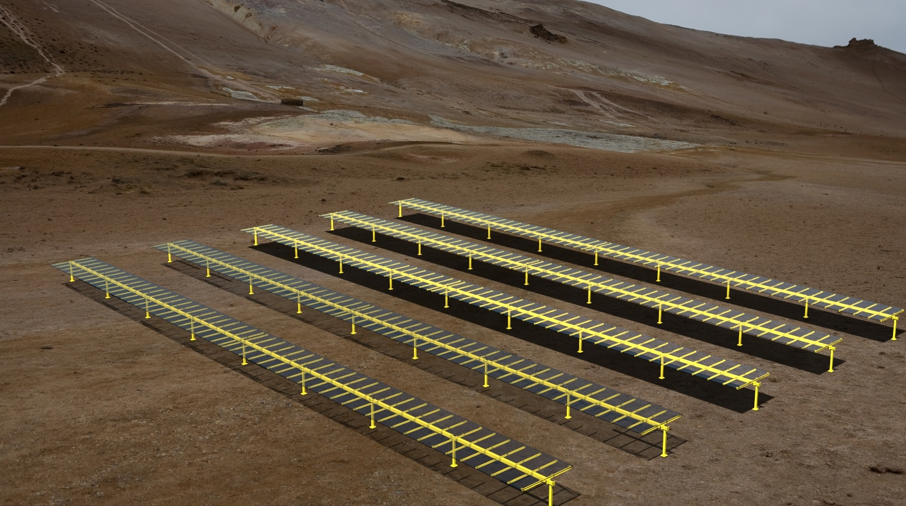
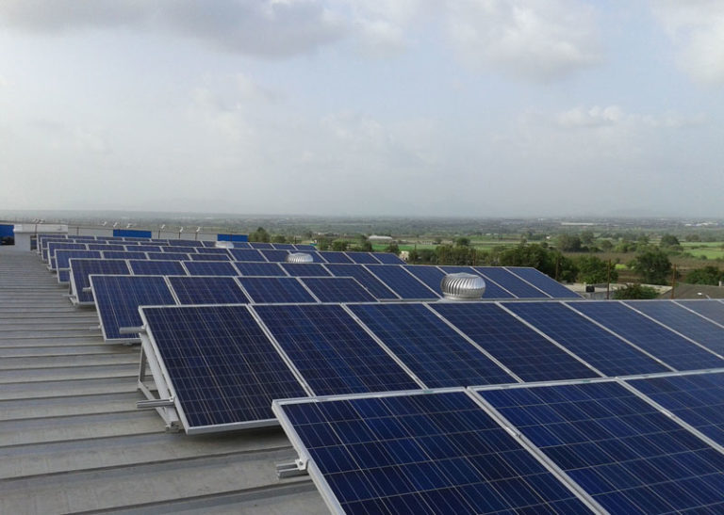
COST ANALYSIS PROJECTS
Customer Overview
A Leading Solar Structure Company
Management Challenges
PCPL Approach
Value Delivered
To launch the Solar structure with competitive price
Ensure that the target price of commodities is in line with the budgeted price
Ease of Assembly time at onsite to reduce labor cost and other hidden cost
Ensure Customer satisfaction with lower price at high durability
From the available CAD data and technical specifications, prepare the BOM.
Develop the manufacturing process plan for each component based on the commodity - Pultrusion, Assembly, Hand Molding & fabrication
Preparing the Should-Cost models for all individual components in the assembly.
Generation of the assembly cost model.
Identified savings (Cost and Weight) in product
Overall 20 % cost reduction achieved as compared to base cost data
Overall 46.48% mass reduction

Slide 3
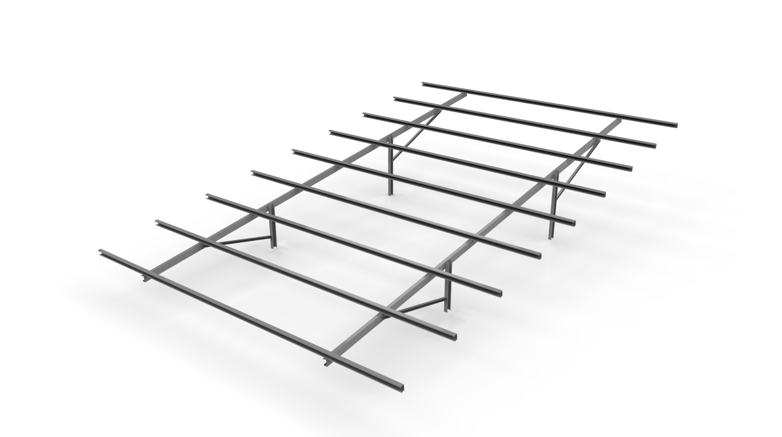
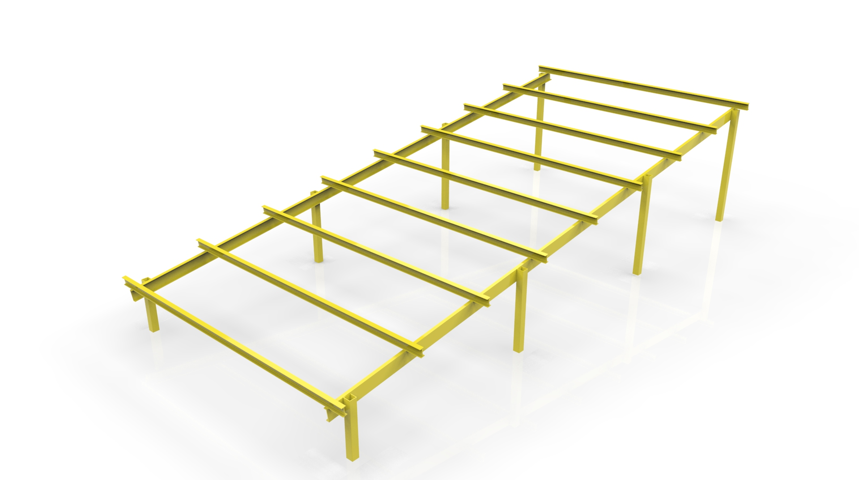
Solar Structure : Stationary
Customers Objective
PCPL’s Solution :
Mass and Cost Effective Rotating Solar Structure Design for a solar energy organization using advanced FRP Product
Design Phases :
Concept Design
Proto Phase
Manufacturing Phase
Duration: 1.5 months
Software used: Solidworks 2016 and Ansys
(Our partner Company did the iteration)
Initial concept design
Generate CAD model
FEA simulation for Wind Load IS-875,
Detail design ready with CAD models, thickness and fillets provided, Manufacturability with Composite rules.
Detailed engineering
Manufacturing drawing
Complete clash and interference analysis
Inputs Provided
Reference data of (CAD Data-2D/3D)
Carry-over parts CAD-2D/3D
Exploded views of Assembly (Images)
Bill of Material

Slide 4
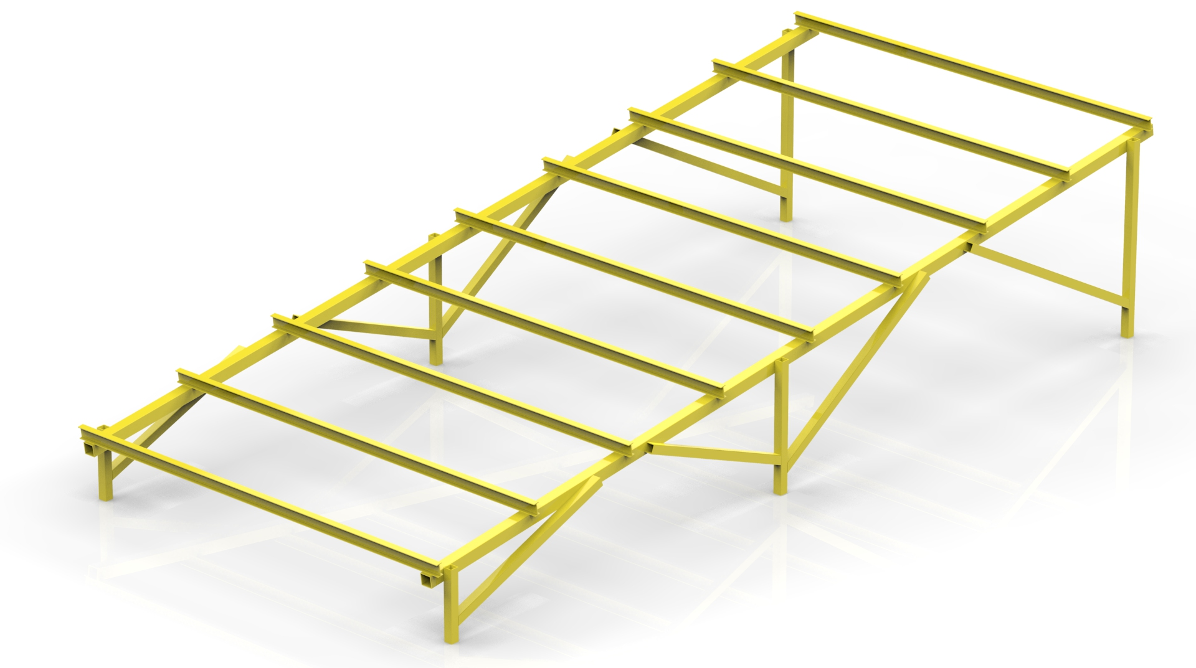
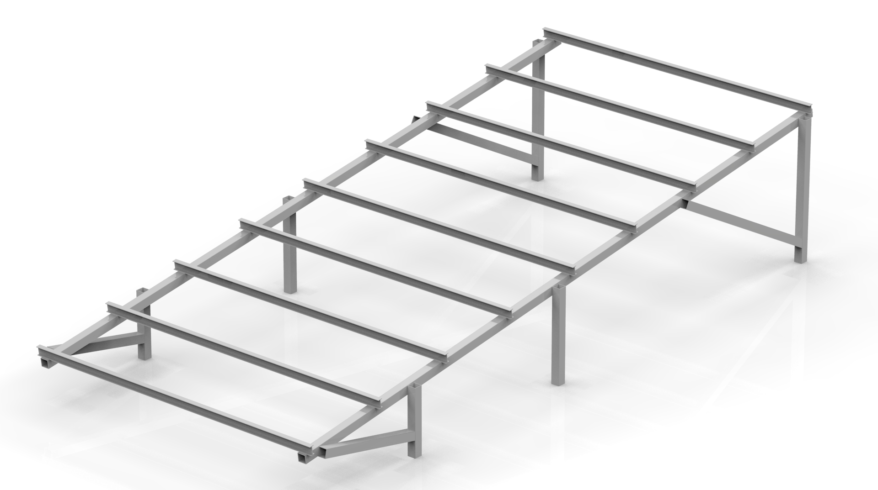
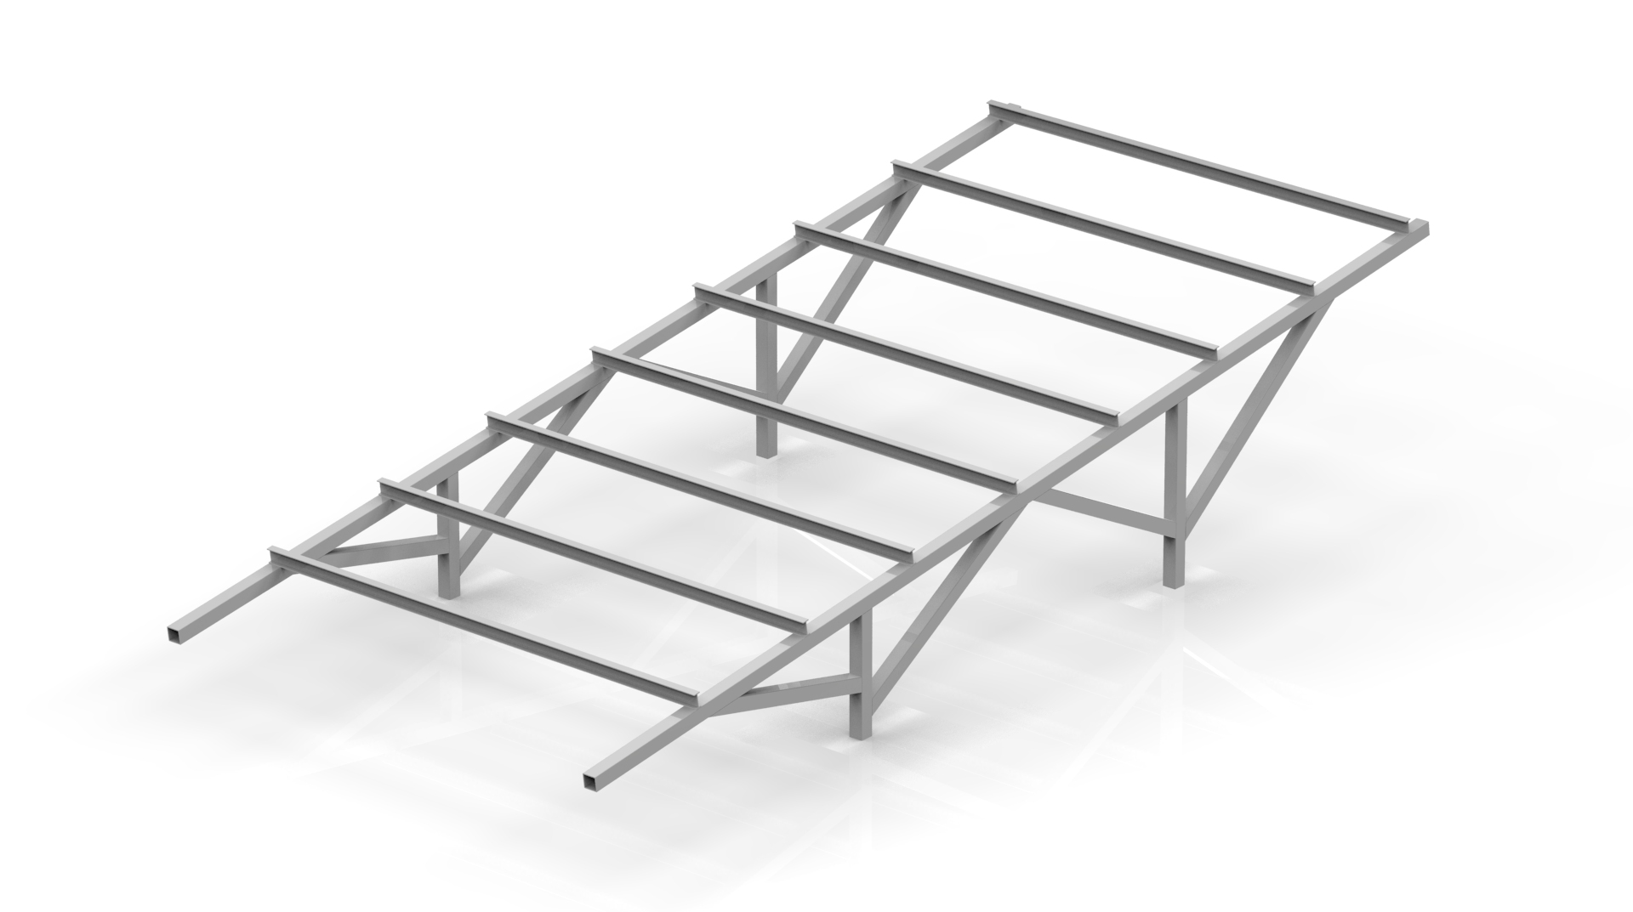
Solar Structure : Stationary
Deliverable:
Different Concepts Developed Into Concrete Designs and Evaluated for Mass, Performance, Cost and Manufacturability
  Concept 1 : New Material (FRP Pultrusion)
  Concept 2 : Optimized mass
  Concept 3 : New Topology and material (Easy Assembly)
  Concept 4 : Optimized mass
Manufacturing feasible final design
Design Steps:
Solar Structure Concept generation.
Generation 3D CAD model.
Analysis of three Concepts, optimization of each concepts for mass.
Pugh matrix for comparing 3 concepts in terms of Mass, manufacturability, cost and Selection Of Final Concept
Manufacturing Feasibility and Cost Analysis
Design Optimization and Final design
Concept 1 Design
Concept 2 Design
Concept 3 Design
Concept 4 Design
Design Changes / New Materials
Design Changes / Optimized mass
Design Changes / Easy Assembly/ Optimized mass
Design Changes / Optimized mass
Mass Optimization
Final Design
Manufacturing feasibility

Slide 5
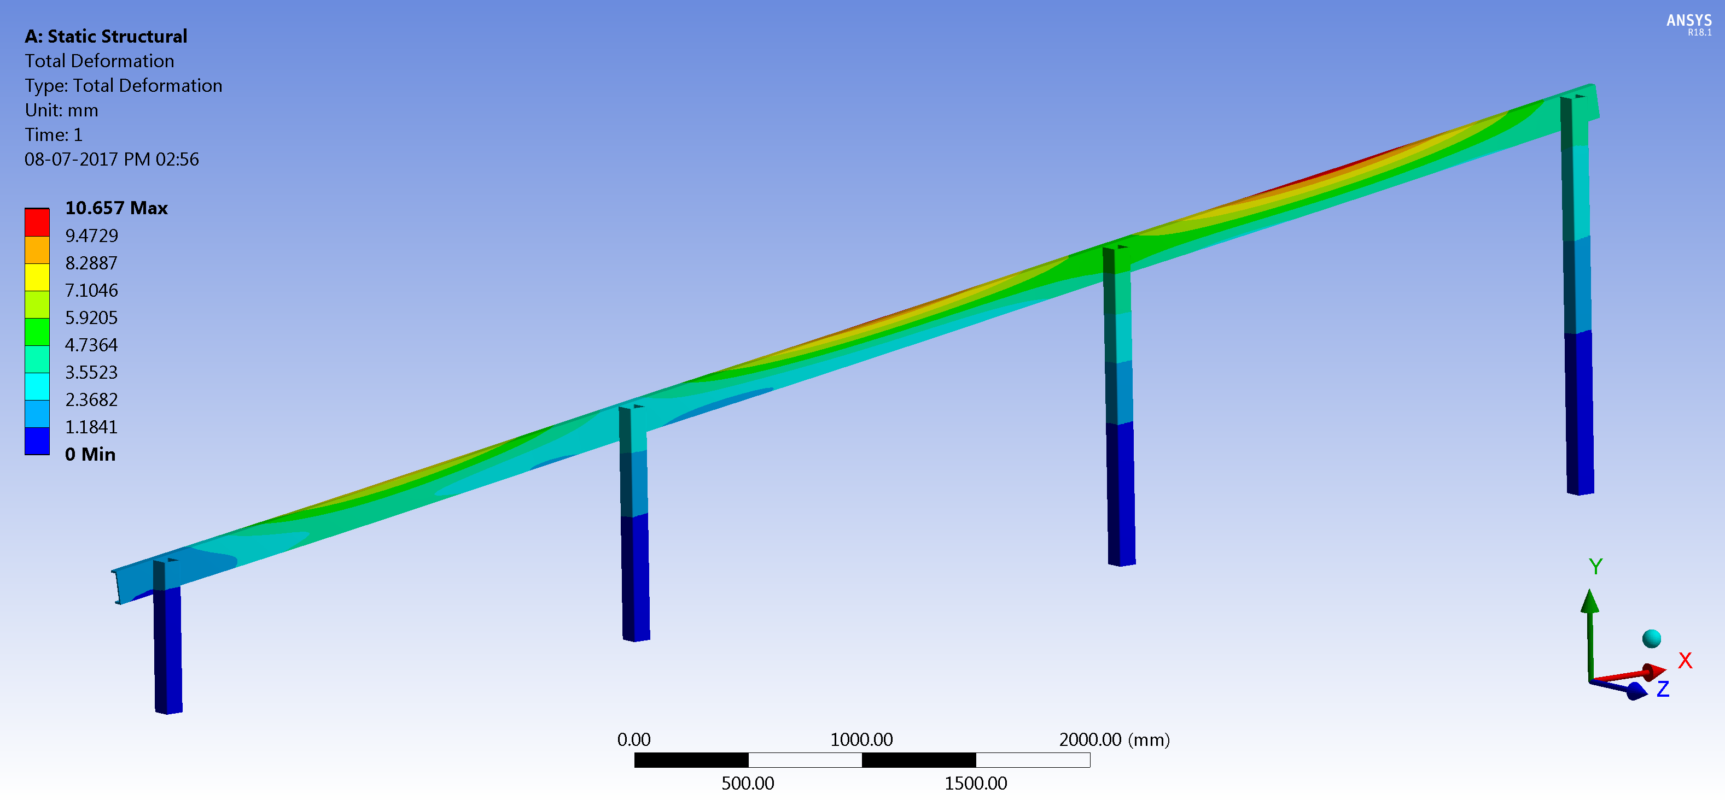
Solar Structure : Stationary
SCOPE: Weight optimization of Stationary Solar Structure
Baseline Structure
MS Total Weight (kg) | FRP Weight (kg) | % Difference in Weight
477.5 | 162.85 | 65.89
Modified Structure

Slide 6
Solar Structure : Stationary
CONCLUSION:
  The total mass reduction achieved in the modified case is 315 kg
  Overall 65.89 % mass reduction.
  Improves power to weight ratio.
  Cost reduction per solar structure by 36.2 %.
  Simplifies assembly of the system.
  Reduces production cost, inventory and labor cost etc.
19/10/2024
<number>

Slide 7
COST ANALYSIS PROJECTS
Customer Overview
A Leading Solar Structure Company
Management Challenges
PCPL Approach
Value Delivered
To launch the Solar structure with competitive price
Ensure that the target price of commodities is in line with the budgeted price
Ease of Assembly time at onsite to reduce labor cost and other hidden cost
Ensure Customer satisfaction with lower price at high durability
From the available CAD data and technical specifications, prepare the BOM.
Develop the manufacturing process plan for each component based on the commodity - Pultrusion, Assembly, Hand Molding & fabrication
Preparing the Should-Cost models for all individual components in the assembly.
Generation of the assembly cost model.
Identified savings (Cost and Weight) in product
Overall 36.2 % cost reduction achieved as compared to base cost data
Overall 65.89 % mass reduction

Slide 8
Rotating Solar Structure

Slide 9
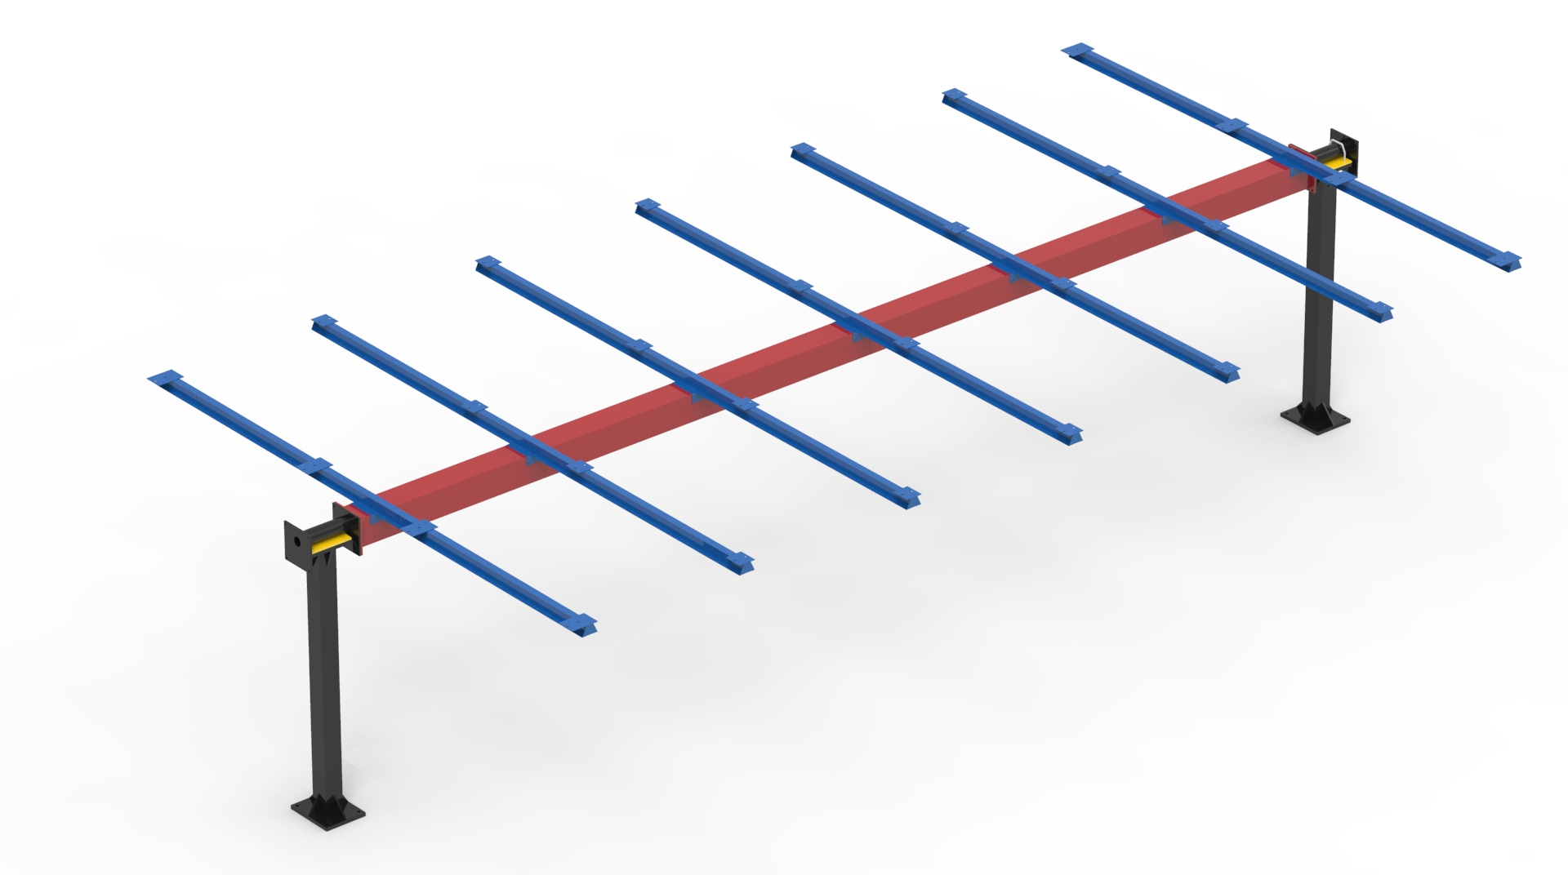
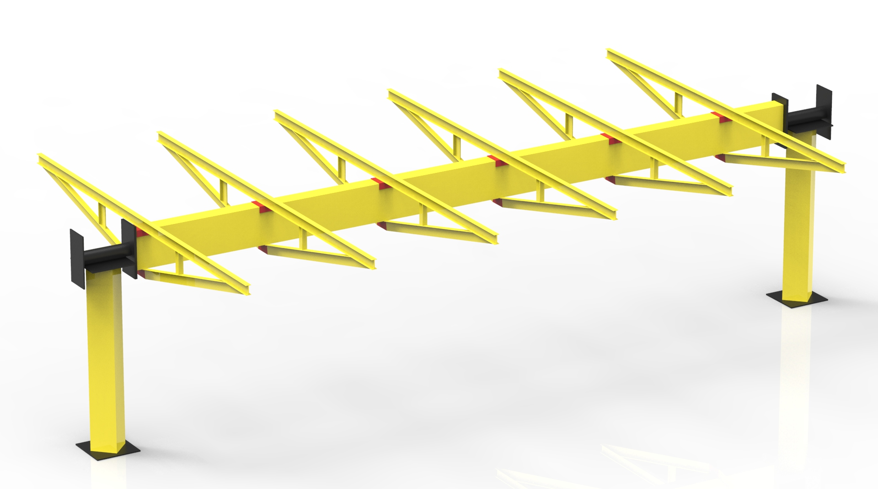
Rotating Solar Structure
Customers Objective
PCPL’s Solution :
Mass and Cost-Effective Rotating Solar Structure Design for Relyon Solar using Advanced FRP Product
Design Phases :
Concept Design
Proto Phase
Manufacturing Phase
Duration : 3 months
Software used: Solidworks 2016 and Ansys
(Our partner Company did the iteration)
Initial concept design
Generate CAD model
FEA simulation for Wind Load IS-875,
Detail design ready with CAD models, thickness and fillets provided, Manufacturability with Composite rules.
Detailed engineering
Manufacturing drawing
Complete clash and interference analysis
Inputs Provided
Reference data of (CAD Data-2D/3D)
Carry-over parts CAD-2D/3D
Exploded views of Assembly (Images)
Bill of Material

Slide 10
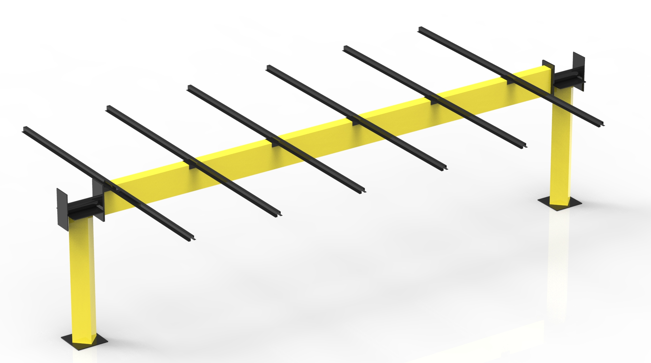
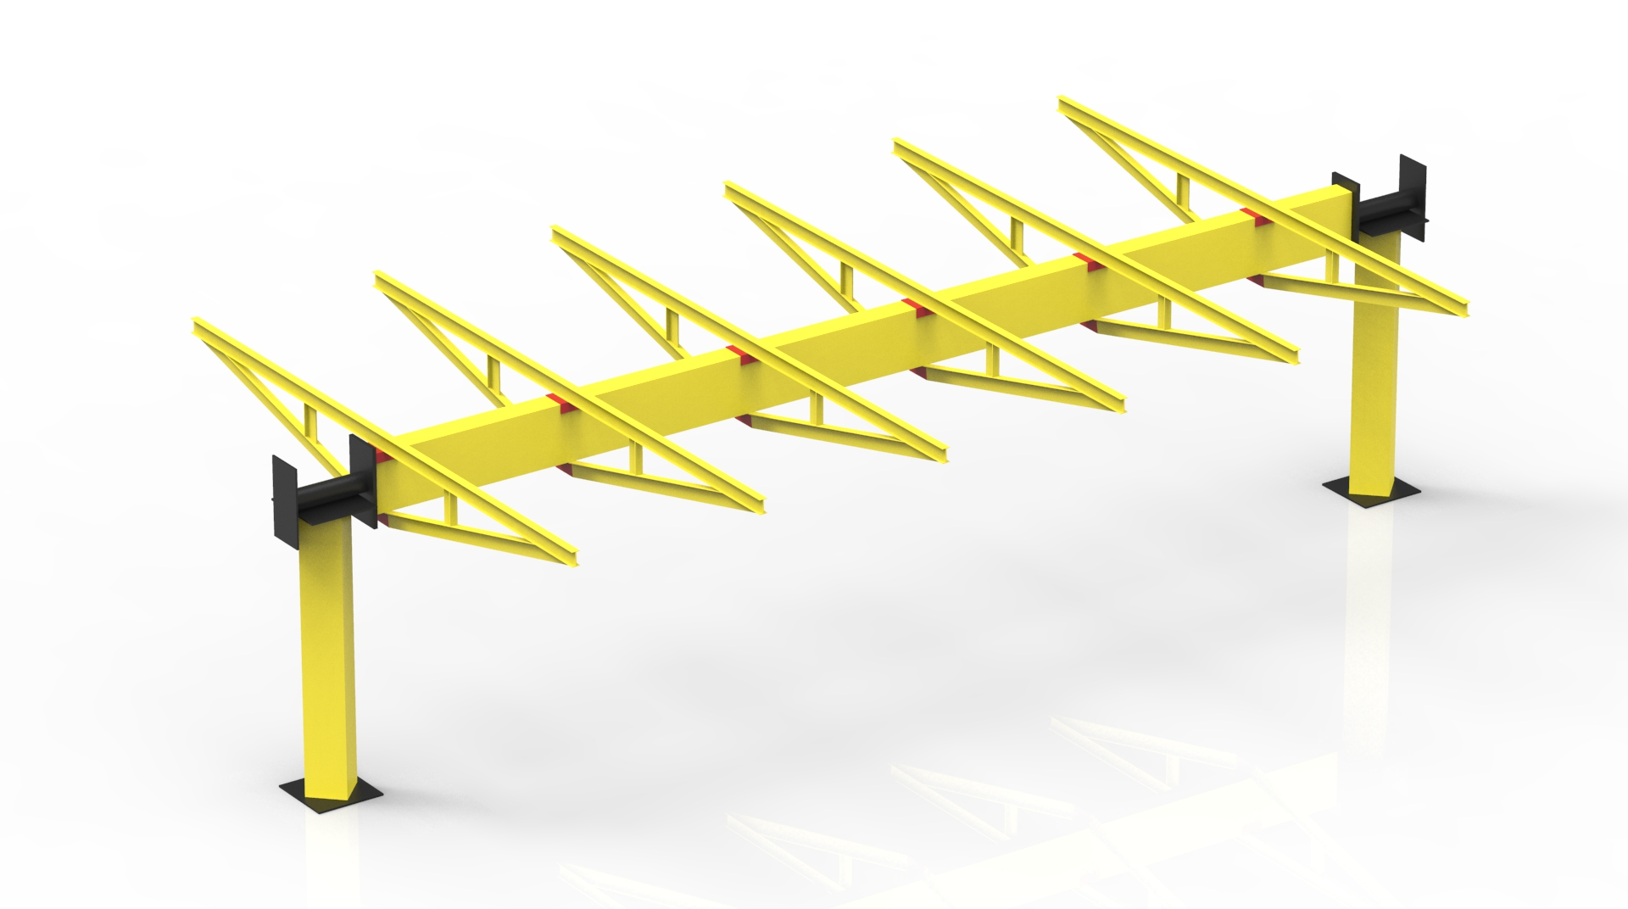
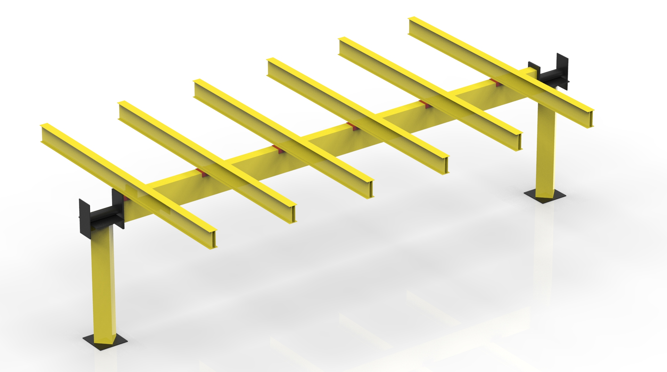
Rotating Solar Structure
Scope/Objective:
Develop Mass Efficient Design Solutions With Advanced FRP Applications For rotating solar structure.
Solar Structure Assembly resistance to load should be 180 km/hr (50 m/s) according to IS-875 at the allowable displacement of 30 mm.
Input :
CAD data/FE models of Solar Structure, Material properties.
Deliverable:
Different Concepts Developed Into Concrete Designs and Evaluated for Mass, Performance, Cost and Manufacturability
  Concept 1 : New Material (FRP Pultrusion)
  Concept 2 : New Topology (Mass saving)
  Concept 3 : New Topology and material (Easy Assembly)
Manufacturing feasible final design
Concept 1 Design
Concept 2 Design
Concept 3 Design
Design Changes / New Materials
Design Changes /New Topology
Design Changes / Easy Assembly
Design Steps:
Solar Structure Concept generation.
Generation 3D CAD model.
Analysis of three Concepts, optimization of each concepts for mass.
Pugh matrix for comparing 3 concepts in terms of Mass, manufacturability, cost and Selection Of Final Concept
Manufacturing Feasibility and Cost Analysis
Design Optimization and Final design
Mass Optimization
Final Design
Manufacturing feasibility

Slide 11
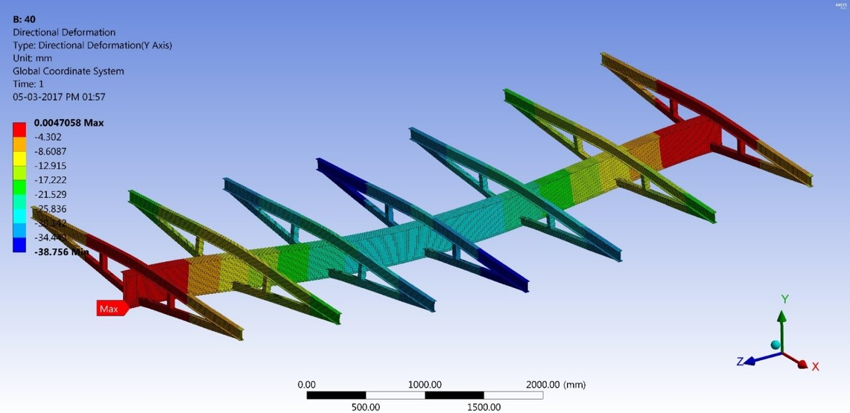
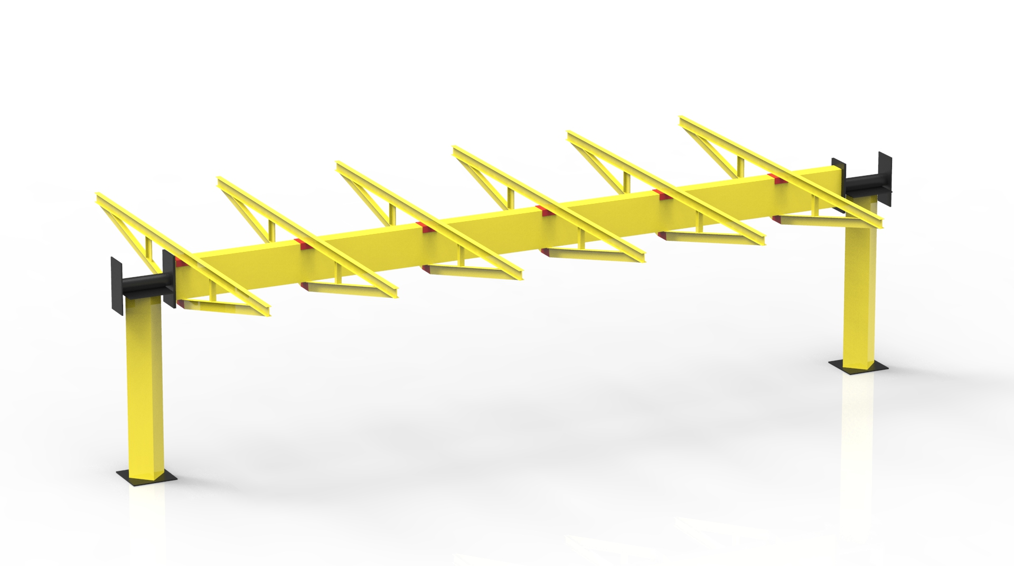
Rotating Solar Structure
SCOPE: Weight optimization of Rotating Solar Structure
Description | MS Weight | Qty | MS Total Weight | FRP Weight | % Difference in Weight
Torque Tube | 114.34 | 8 | 914.72 | 526.20 | 42.47
Hat Sec-1 | 11.44 | 44 | 599.2 | 362.08 | 39.57
Hat Sec-2 | 11.98 | 8
Column-1 | 39.52 | 8 | 316.16 | 76.11 | 75.93
Column-2 | 47.2 | 1 | 47.2 | 11.29 | 76.08
Bearing Circular Pipe | 7.83 | 8 | 62.64 | 62.64 | 0.00
Total Weight (kg) |  |  | 1939.92 | 1038.32 | 46.48
Baseline Structure
Modified Structure

Slide 12
CASE STUDY – Rotating Solar Structure
CONCLUSION:
  The total mass reduction achieved in the modified case is 902 kg
  Overall 46.48% mass reduction.
  Improves power to weight ratio.
  Cost reduction per solar structure by 20%.
  Simplifies assembly of the system.
  Reduces production cost, inventory and labor cost etc.
19/10/2024
<number>

Slide 13
COST ANALYSIS PROJECTS
Customer Overview
A Leading Solar Structure Company
Management Challenges
PCPL Approach
Value Delivered
To launch the Solar structure with competitive price
Ensure that the target price of commodities is in line with the budgeted price
Ease of Assembly time at onsite to reduce labor cost and other hidden cost
Ensure Customer satisfaction with lower price at high durability
From the available CAD data and technical specifications, prepare the BOM.
Develop the manufacturing process plan for each component based on the commodity - Pultrusion, Assembly, Hand Molding & fabrication
Preparing the Should-Cost models for all individual components in the assembly.
Generation of the assembly cost model.
Identified savings (Cost and Weight) in product
Overall 20 % cost reduction achieved as compared to base cost data
Overall 46.48% mass reduction

